Slide 1
CE2101 Example Class 3
Done by: Kah Hoa, Rui Hong, Yan Qi

Slide 2
(1) Give a recursive definition of the function P(C)

Slide 3
What is recursion?
Repeated Application of the same procedure on subproblems of the same type of a problem.
Recursion in function P(C)
P(C) finds the largest total profit of the set by trying different combinations with N types of objects, each object with different profit P and weight W given a knapsack of capacity C.
The function utilizes certain objects repetitively in search of the optimal profit value, invoking itself within the function to find different combinations until the maximum profit is yield given a limited knapsack capacity of C.

Slide 4
Recursion in the function P(C)
P(int C, int weight, int profit, int length of objects)
{ if(length of objects == 0 || C == 0)
return 0;
if(weight of nth object > C)
return P(C, weight, profit, length of objects);
else
return max(profit of the n-1 object+ P(C - weight of n-1 object, weight, profit, length of objects -1),
P(C, weight, profit, length of objects - 1);
}
max(int a, int b) { if(a > b)
return a;
else
return b;
}
Time Complexity = O(2^n)

Slide 5
Recursive definition
P(C) = max((profit of the n-1 object + P(C - weight of n-1 object, weight, profit, length of objects -1), P(C, weight, profit, length of objects - 1))

Slide 6
(2) Draw the subproblem graph for P(14) where n is 3 with the weights and profits given below.
0 | 1 | 2
Wi | 4 | 6 | 8
Pi | 7 | 6 | 9

Slide 7
0 | 1 | 2
P(2)
Wi | 4 | 6 | 8
Pi | 7 | 6 | 9
0
Profit = 9 + 7
P(6)
1
P(0)
Profit = 6 + 9
P(0)
Profit = 6 + 9
2
2
P(8)
P(4)
P(0)
0
0
Profit = 6 + 7 + 7
1
1
P(14)
P(2)
Profit = 6 + 6
0
P(2)
Profit = 9 + 7
2
P(10)
1
P(4)
0
P(0)
Profit = 7 + 6 + 7
0
P(6)
P(2)
0
Profit = 7 + 7 + 7

Slide 8
(3) Give a dynamic programming algorithm to compute the maximum profit, given a knapsack of capacity C, n types of objects with weights wi and profits pi using the bottom up approach.

Slide 9
Int P(int C , int n , int []wi , int []pi)
{
int maxProfit[C+1];
for i=0 to C
maxProfit[i] = 0;
for i=0 to C
for j=0 to n //iterate through n objects at each capacity
if (wi[j] <= i) //checking if weight of object is smaller than capacity i
maxProfit[i] = max(maxProfit[i] , maxProfit[i - w[j]] + pi[j]);
return maxProfit[C];
}
O(C)
O(nC)
Time Complexity : 0(nC)
Space Complexity: 0(C)

Slide 10
(4) Code your algorithm in a programming language
a. show the running result of P(14) with weights and profits given in (2).
b. Show the running result of P(14) with weights and profits given below. You should show the program input and the output in (a) and (b).

Slide 11
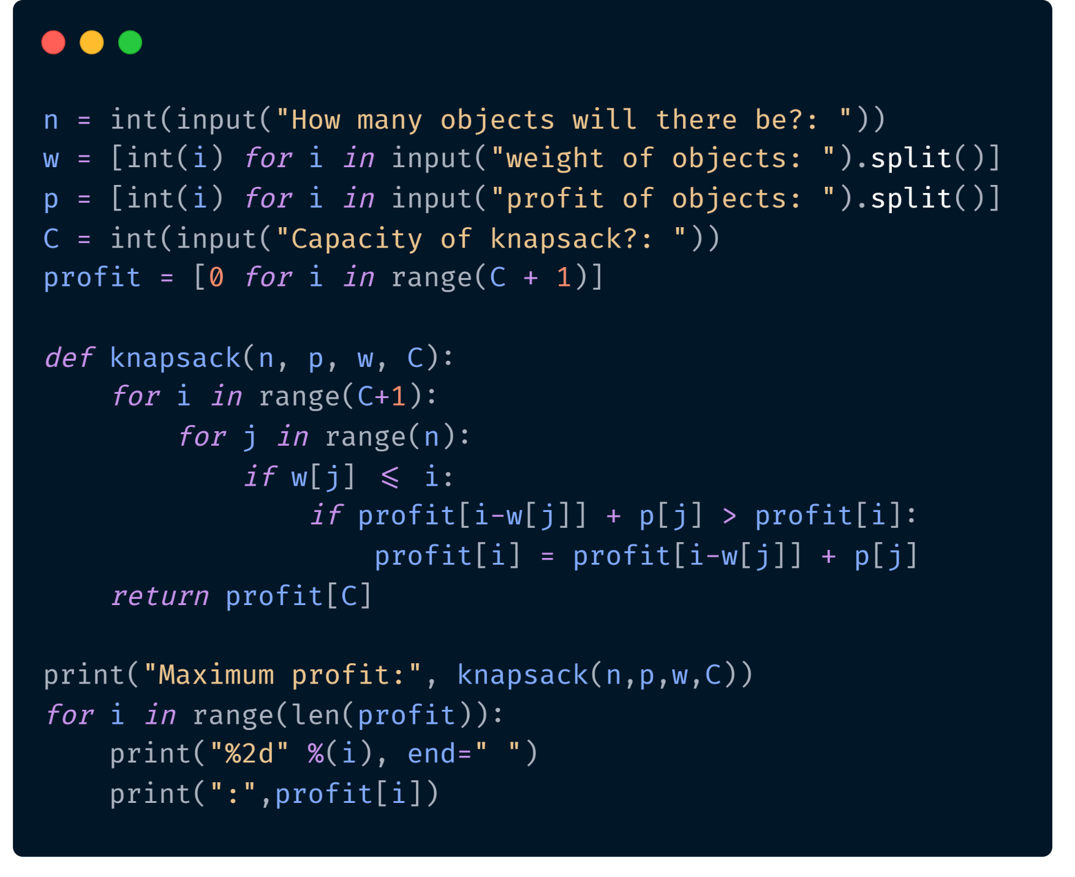

Slide 12
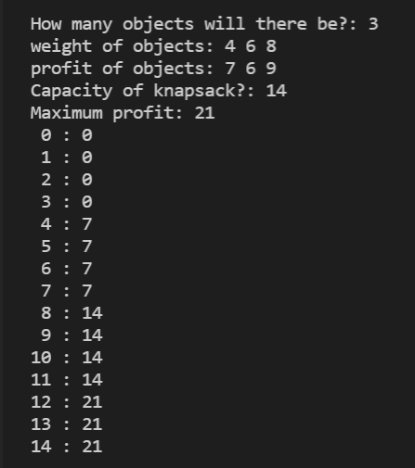
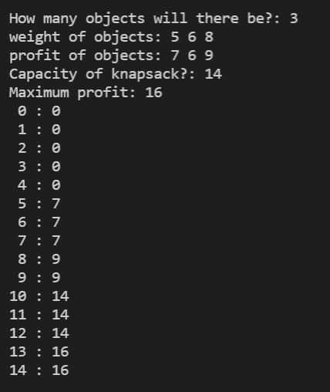
Profit = 7
Profit = 7
Profit = 7 + 7 = 14
Profit = 9
Profit = 7 + 7 = 14
Profit = 14 + 7 = 21
Profit = 9 + 7 = 16

Slide 13
THANK YOU!

